Slide 1
SYLLABUS
Analog indicating instruments
Damping devices
PMMC ammeters and voltmeters
Shunt and multipliers
Moving iron ammeter and voltmeters
Dynamometer type wattmeters
Multimeters
AC watt-hour meters
Digital voltmeters, ammeters and wattmeters

Slide 2
BASIC ANALOG INSTRUMENTS
An instrument is a device for displaying, recording, / finding the value or magnitude of a quantity or variable.
Instrumentation is a system for measuring , processing, storing, displaying, etc. a quantity or variable. For example, transducer to display unit.
Accuracy: It is the nearness( closeness) of the value towards the true value,

Slide 3
i.e. the measure of conformity to the true value.
Precision: It refers to the degree of agreement with a group of measurements or instruments i. e. the measure of reproducibility. Precision has two characteristics:
(i) Conformity, and the
(ii) Number of significant figures to which measurements may be made.

Slide 4
Resolution
RESOLUTION: It is defined as the smallest change input that can be detected by an instrument.
SENSITIVITY: It is the ratio of output signal or response of the instrument to a change of input or measured variable.
TRUE VALUE: It is the average of the infinite number of measurement, when the average devitation tends to be zero.
Error: an error is a deviation from true value of the measured variable.
Classification of instruments:
1. Absolute instrument- These give the quantity to be measured in terms of an instrument constant and its deflection e.g. tangent galvanometer

Slide 5
2. Secondary Instruments: These give the magnitude of the electrical quantity to be measured directly e.g. ammeter, voltmeter, wattmeter etc. These are also classified on the basis of the type of input provided to them.:
Analog instruments
Digital instruments
c) Intelligent instrument
d) Virtual instrument

Slide 6
Basic requirements for analoge instrument
For a satisfactory working of indicating instruments, the following three types of torques are required:
1. Deflection (Operating) torque : it is necessary to make the moving system of the instrument (pointer) move from its zero position.
T dc = NBild = Gi
Therefore: T dc ∝ measurand
Where
N= number of turns of coil
B= flux density in the air-gap at the coil position
l= length of vertical side of coil
d= length of horizontal side of coil
i= current through the coil
G= Nbid is called the displacement constant of the galvanometer

Slide 7
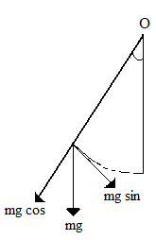
2. Controlling (restoring) torque: some controlling force is employed either by a spring or gravity to limit the movement.
a) Spring is generally used for controlling torque (phosphor bronze is the most suitable material)
T c = Kθ
Where θ is the deflection of the pointer and K is the
controlling torque constant.
b) Gravity method as shown in the fig.
is also sometimes used for controlling
torque
T c ∝ sin θ
θ
θ
θ

Slide 8
3. Damping torque – This torque is necessary to avoid oscillation of the moving system about its final deflected position owing to the inertia of the moving parts and to bring the moving system to rest in its deflected position quickly.
The various methods of obtaining damping are air friction, fluid friction and eddy current.

Slide 9
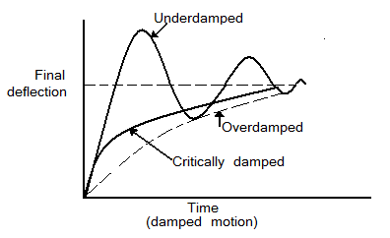
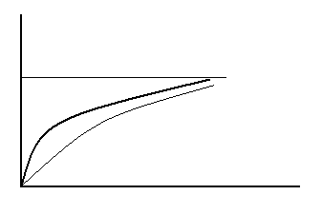

Slide 10
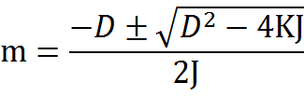
Damping Torque Τ_{dm} =D dθ/dt ……………..(1)
Where D is the damping constant
The retarding torque due to ineretia of the moving system is Τi = J(d²θ/dt²) ……………….(2)
Where J is called the inertia constant.
Equation of damping motion
The general differential equation of damping motion is
J(d²θ/dt²)+ D dθ/dt +Kθ = Gi ……………..(3)
Hence the auxiliary equation is
Jm²+Dm+K=0 ………………. (4)
Therefore

Slide 11
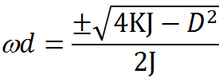
Thus deflection θ= Ae^{m}₁^{t} +Be^{m}₂^{t}
Under steady state, (d²θ/dt²) =0, dθ/dt =0, θ =θ_{f}
θ_{f} =Gi/K
Where is the final steady state deflection
_{Case 1. if}
D²< 4KJ then the response is under damped
Case 2. If D²= 4KJ then the response is critically damped
Case 3 if D²> 4KJ then the response is over damped.
The angular frequency of damped oscillation is
For critical damping ,D= 2√(KJ) =G²/R
Therefore, R = G²/2√(KJ)
Where r is the series resistance for critical damping.

Slide 12
Electromagnetic Damping
Electromagnetic damping is produced by the induced effects when the coil moves in the magnetic field and a closed path is provided for the currents to flow. Electromagnetic damping is because of
1.Eddy currents produced in the metal core,
2.Current circulated in the coil circuit by emf generated in the coil when it rotates.

Slide 13
Ammeters & Voltmeters
Deflection of indicating pointers for both ammeters and voltmeters depends on the torque produced by the current flowing through them.In the case of Ammeter, the torque is produced by the current to be measured or a known fraction of it. The torque in a voltmeter is produced by the current proportional to be measured. Thus, the principle of operation in both ammeters and voltmeters is same.
A voltmeter is a high-resistance instrument since it is connected across the voltage to be measured. The high resistance permits only a small amount of current to flow through the voltmeter.

Slide 14
On the other hand, an ammeter, which is connected in series, is required to have a low resistance so that the current to be measured is not altered.
Thus, it can be seen that ammeters and voltmeters can be used interchangeably. A voltmeter can be used as an ammeter by connecting a low resistance shunt across it. Similarly, an ammeter can be converted into a voltmeter by connecting a high resistance inn series with the former.

Slide 15
Types of Ammeter and Voltmers
The commonly employed ammeters and voltmeters are:
Moving Coil Permanent magnet type
Moving Coil Dynamic Type
Moving iron type
Hot wire (induction) type
Electrostatic Type
Induction Type

Slide 16
Moving coil permanent magnet instruments
In moving type Permanent Magnet instruments the deflating torque is produced by the current. Thus, such instruments can be used for measuring direct currents and voltages only. Induction type instruments depend upon the induction effect produced by alternating quantities. Therefore, such instruments measure alternating quantities only. All other types of instruments can be used for measuring direct and alternating currents and voltages.

Slide 17
Moving coil permanent magnet instruments
These instruments consist of a light rectangular coil of several turns wound on an aluminum or copper former. The aluminum/ copper former provides mechanical strength of the coil. The coil is pivoted and its sides lie on the air gap between the two poles of a powerful U-shaped permanent magnet and a soft iron cylinder. The soft-iron cylinder helps to make the magnetic field radial and reduce the reluctance of the air gap between the poles. The controlling system, which controls the movement of the coil, is constituted of two phosphor-bronze hair springs, these springs also serve as terminals for passing current through the coil. The damping of the moving coil is achieved by eddy currents induced in the aluminium former.

Slide 18
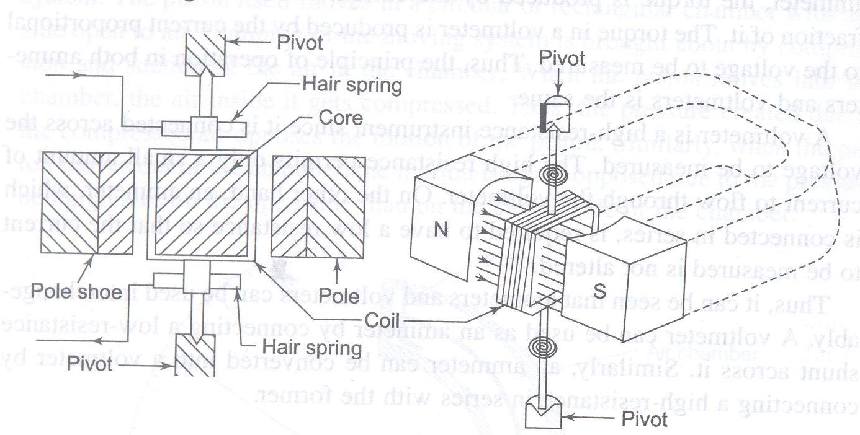
When a current of I ampere flows through the coil, the two sides of the coil experience a force of F Newton.
Fig Construction details of Moving coil Permanent magnet instrument

Slide 19
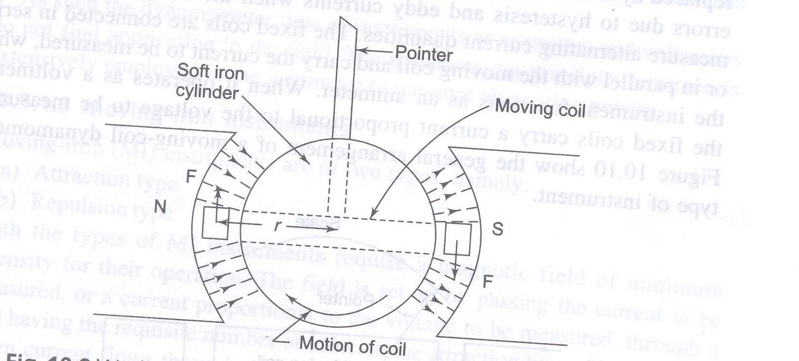
Working of a moving-coil permanent- magnet instrument

Slide 20
F= NBIl newton
Deflecting torque,
T_{d} = F. Perpendicular distance, Nm
= NBI l .b Nm
= NBI .A Nm
For a given instrument N,B, and A are constant, thus T_{d} ∝ I
Since spring control has been used, T_{c} is proportional to θ, the deflection under the condition of equilibrium,
T_{d} ∝T_{c}
I ∝ θ
It can be seen that such an instrument has a scale which is uniformly divided.
The other advantages of this type of instruments are their high sensitivity and their not being affected by stray magnet fields since they are well shielded.

Slide 21
If an alternating current is passed through a moving-coil permanent magnet instrument, the deflecting torque produced on the moving system will be alternation. Therefore, the moving coil will oscillate around its zero position. Thus the main disadvantage of such type of instruments is that they cannot be employed for measuring ac measurements. They are suitable only for dc currents and voltages.

Slide 22
Galvanometer Sensitivity
The sensitivity of a galvanometer can be specified in terms of current sensitivity and voltage sensitivity.
Current sensitivity Sl =d/l.

Slide 23
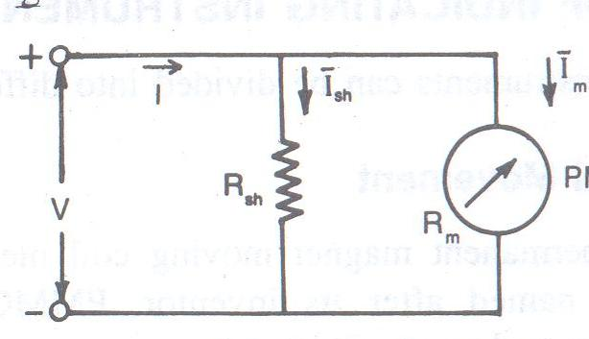
DC Ammeter
The coil winding of PMMC is small and light , It can carry only small current. When large current to be measured it is necessary to by pass the major part of the current through a resistance called a shunt as shown below : then
Fig of DC ammeter

Slide 24
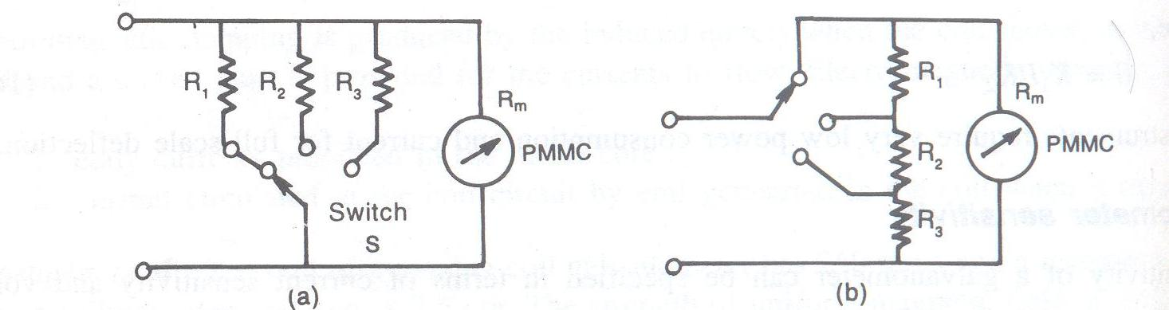
v = I _{SH} r _{SH} = I_{m} R_{m}
I _{SH} = I-I_{m}
we have, Rsh = I_{m} Rm / (I- I_{m} )
= Rm / (m-1), where m= I/ I_{m}
I – full scale current of the ammeter including the shunt
Multi range ammeter

Slide 25
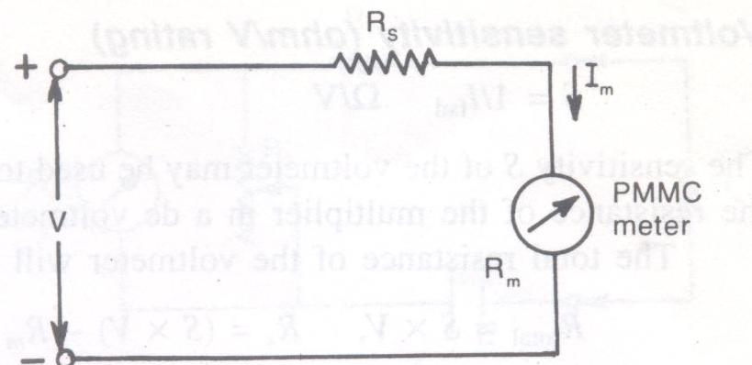
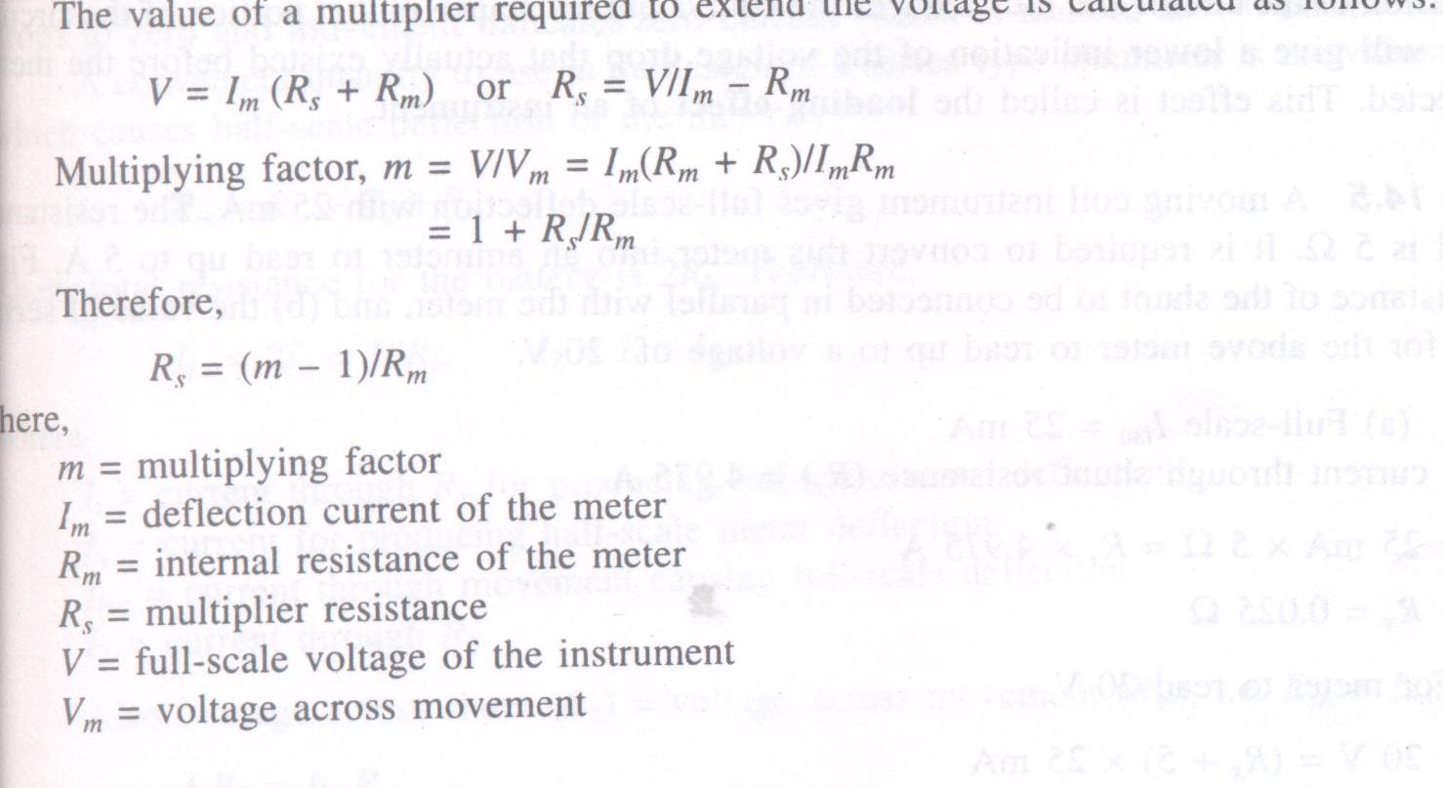
DC voltmeter

Slide 26
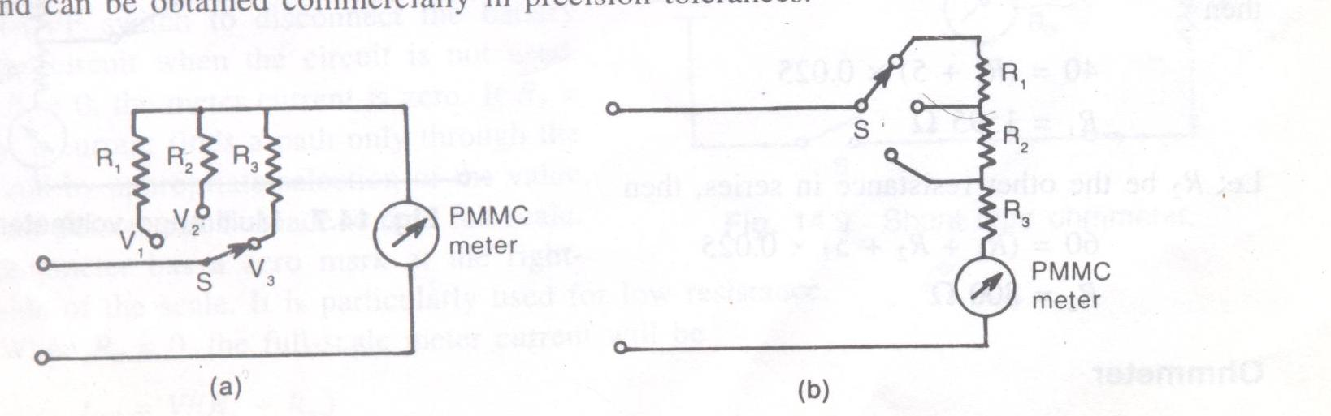
Multi range voltmeter

Slide 27
Voltmeter Sensitivity
S = 1/I fsd Ω/V
The sensitivity S of the voltmeter may be used to advantage in the sensitivity method of calculating the resistance of the multiplier In a dc voltmeter.
The total resistance of the voltmeter will be
R _{total} = S . V,
R_{s} = (S. V) - R_{m}

Slide 28
Loading Effect
A low sensitivity meter may give a correct reading when measuring voltages in a low resistance circuits. A voltmeter when connected across two points in a highly resistive circuit, acts as a shunt for that portion of the circuit and thus reduces the equivalent resistance in that portion of the circuit and thus reduces the equivalent resistance in that portion of the circuit. The meter will give a lower indication of the voltage drop that actually existed before the meter was connected. This effect is called the loading effect of an instrument

Slide 29
Electrodynamometer
It can be used for ac as well dc measurements. It contains two types of coils, a fixed coil and a moving coil. The field is produced by a fixed coil. This coil is divided into two settings to give a more uniform field.
Deflecting Torque = Td = BANI
Where B= flux density of the magnetic field in which the coil moves
A= Area of cross-section of coil
I =Current through coil
N= number of turns of coil

Slide 30
But B ∝ I
Therefore T d ∝ I²
Instantaneous deflecting torque, T i= i1 i2.dM/dθ
Where i1=instantaneous current in the fixed coil
I2 =instantaneous current in the moving coil
M= mutual inductance of coils
θ = deflection of pointer
Operating with DC: T d = I1. I2dM/dθ
Where I1= dc current through fixed coil
I2 = dc current through moving coil
This deflecting torque deflects the moving coil to such a position where the controlling torque(Kθ)
Of the spring is equal to the deflecting torque. Therefore ,

Slide 31
Kθ = I₁ I₂ dM/dθ
θ = (I₁ I₂/K) dM/dθ
Ac Currents:
The meter will show the average value of the deflecting torque. Therefore,
T _{av}= dM/dθ (1/T)∫i₁.i₂ dt
Sinusoidal currents:
Let i₁= I_{m1} sinωt
i₂ = I_{m2} sinωt
T _{av} = dM/dθ (1/T)∫ I_{m1} I_{m2} sinωt sin(ωt-φ)dt
=1/2 (I_{m1} I_{m2})cosφ dM/dθ
therefore, T _{av} = I₁I₂ cosφ dM/dθ
Where I_{1,}I_{2 are the rms values of} i_{1 and} i2 , rspectively.

Slide 32
K θ= I₁ I₂cosφ dM/dθ
θ= 1/K ( I₁ I₂cosφ dM/dθ)

Slide 33
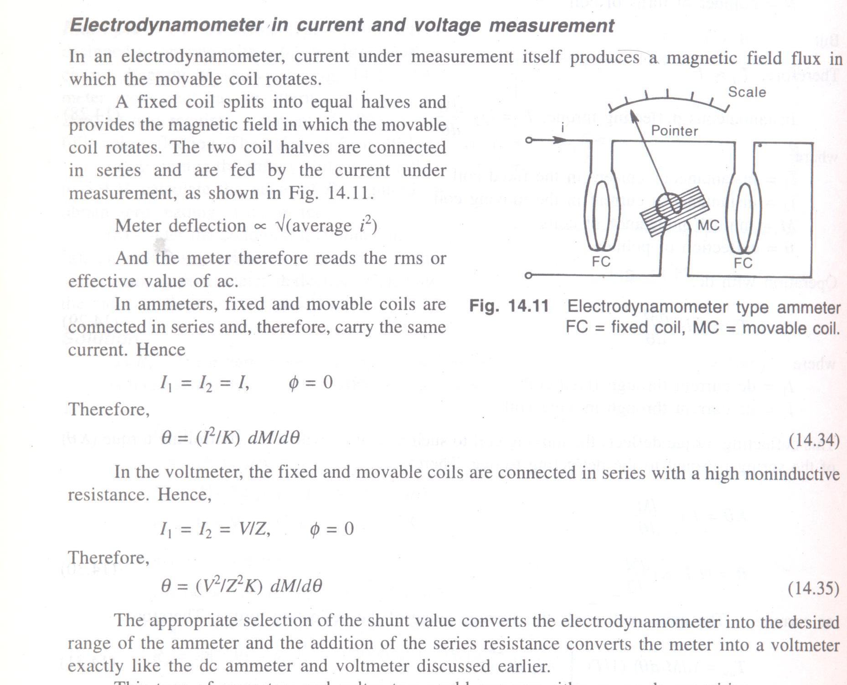

Slide 34
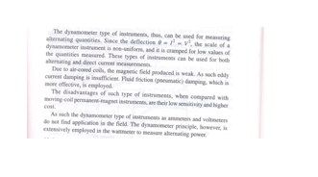

Slide 35
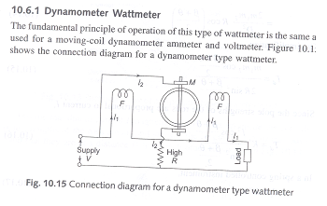

Slide 36
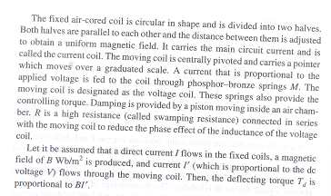

Slide 37
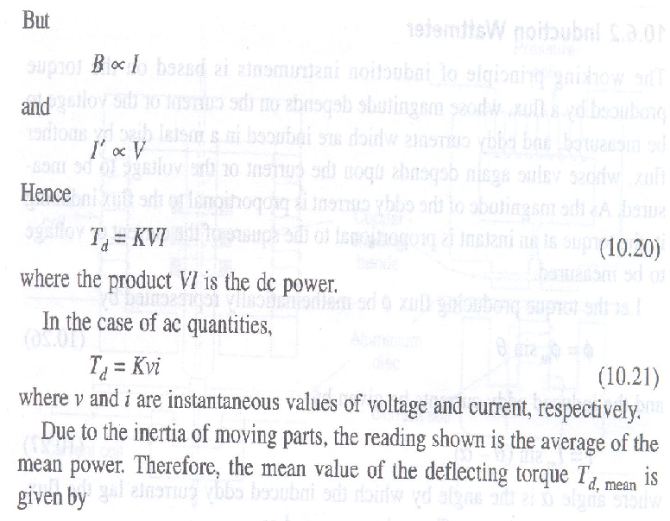

Slide 38
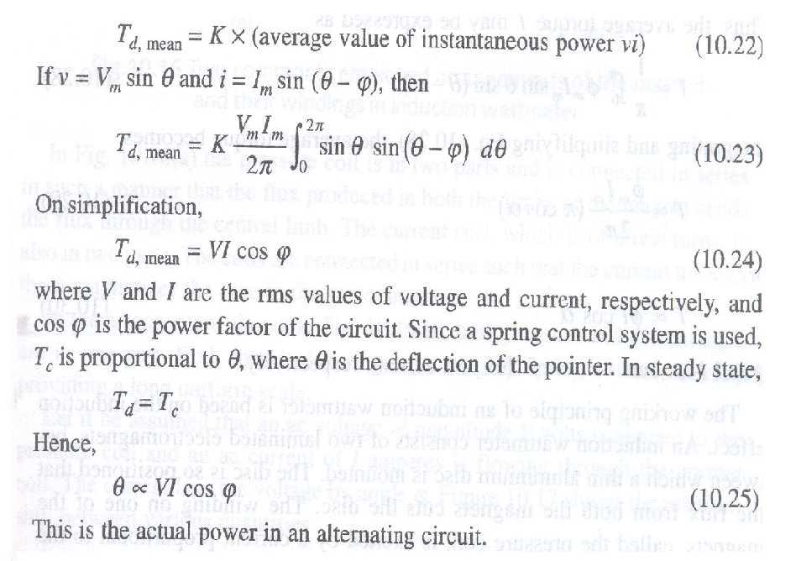

Slide 39
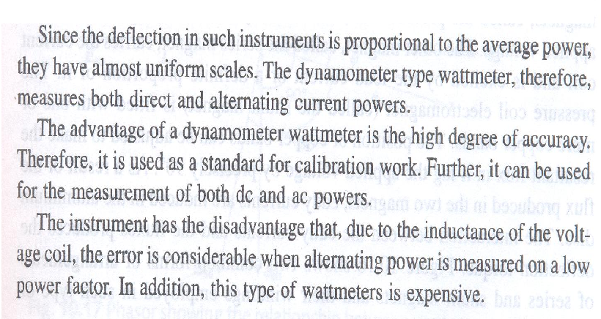

Slide 40
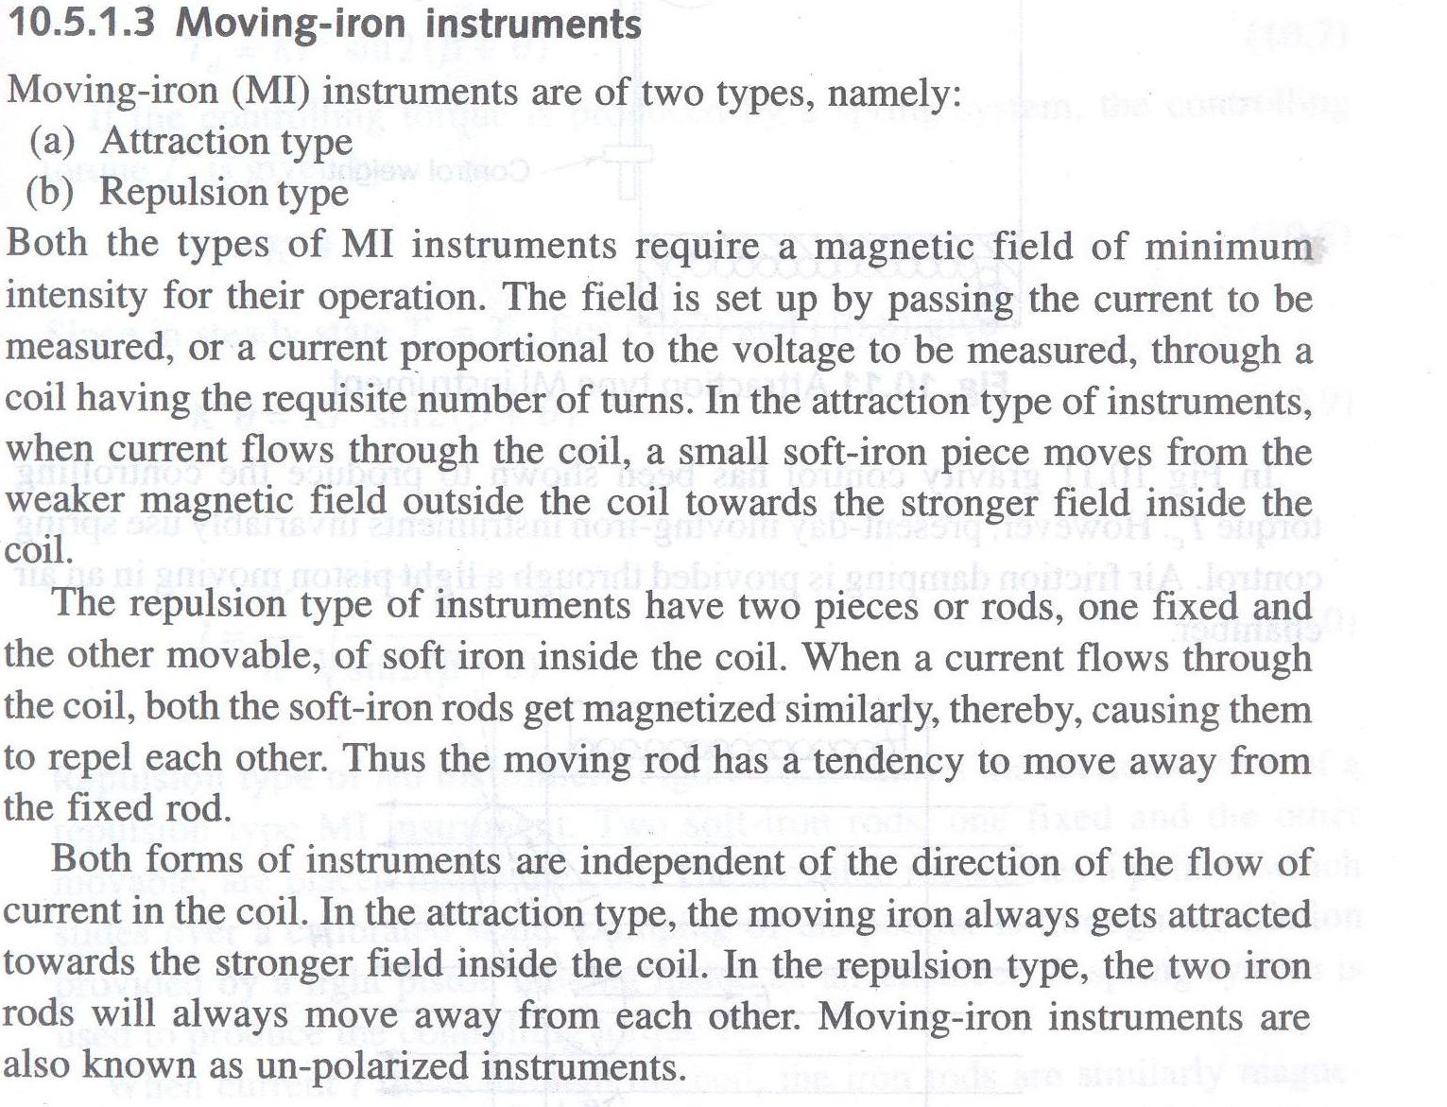

Slide 41
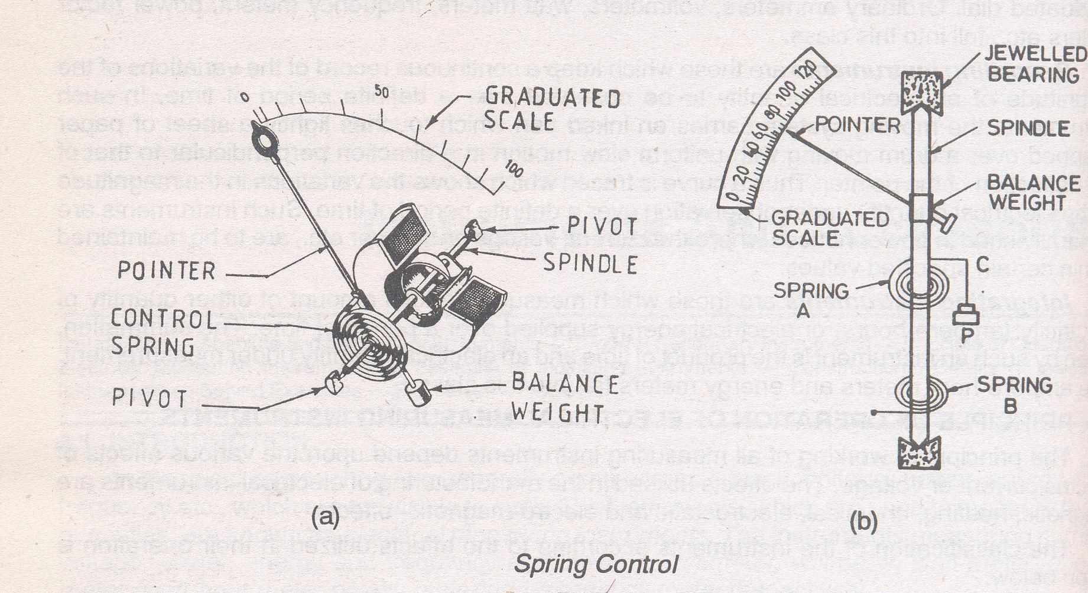

Slide 42
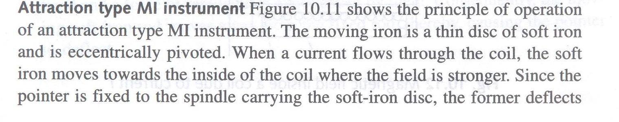
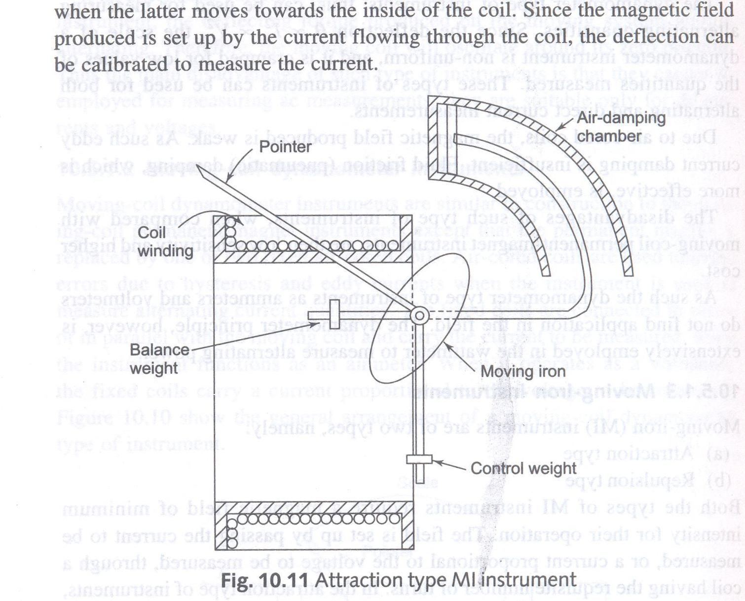

Slide 43
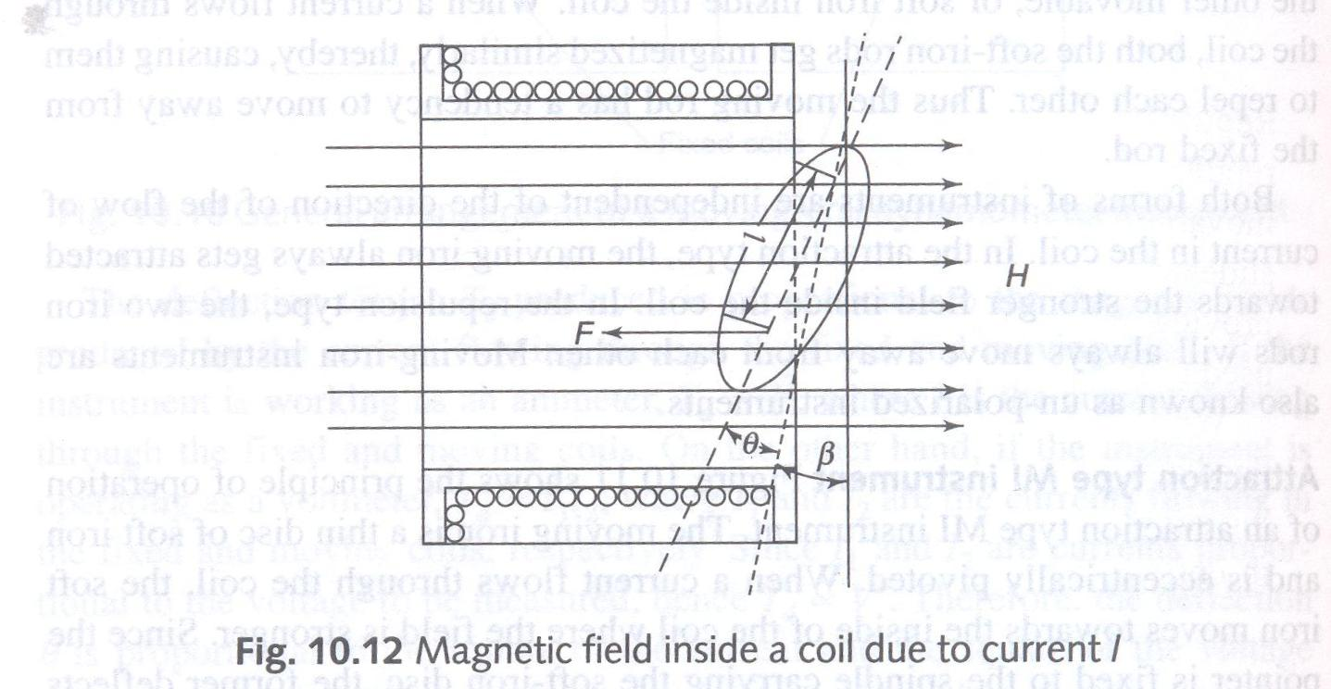

Slide 44
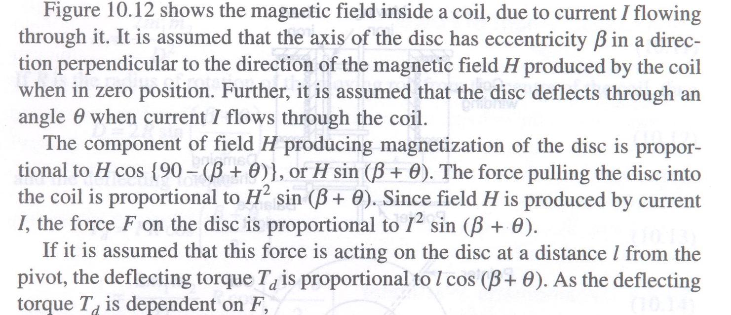

Slide 45
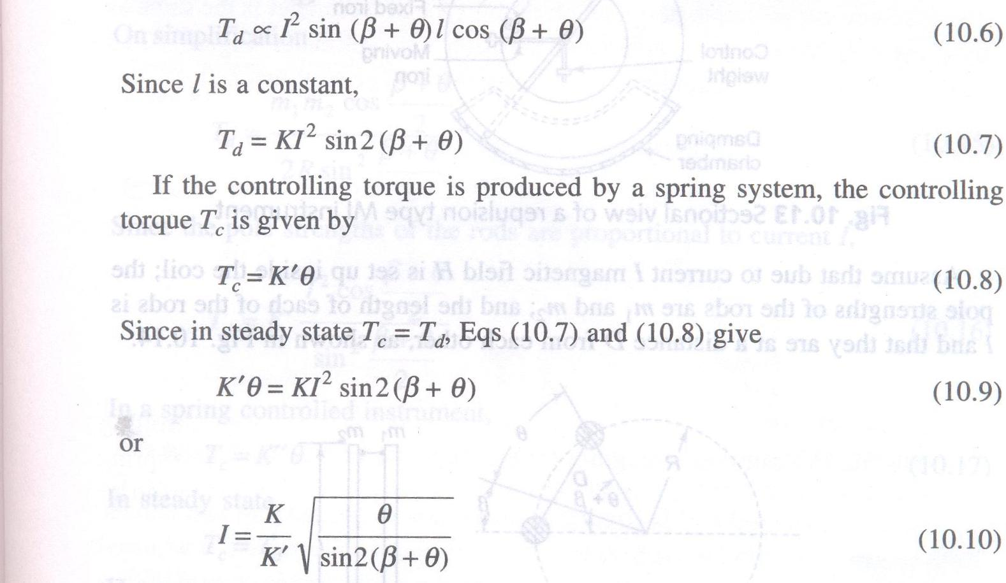

Slide 46
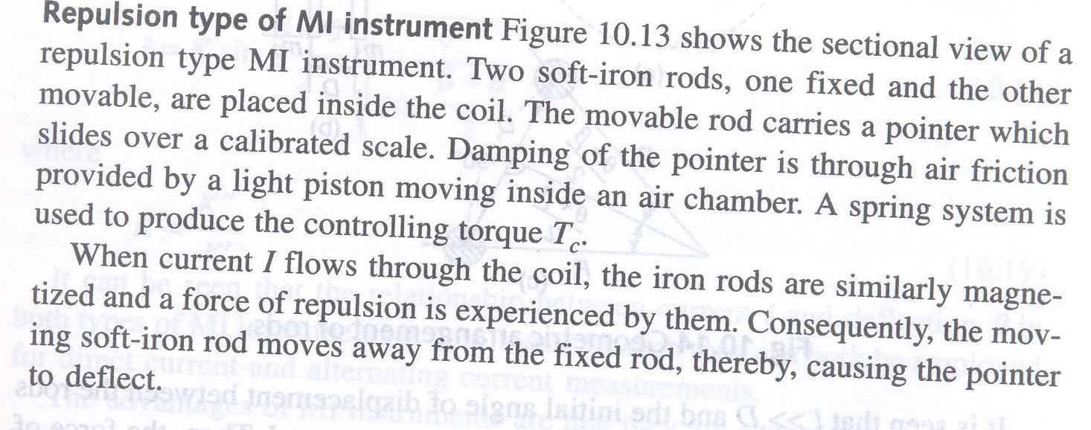
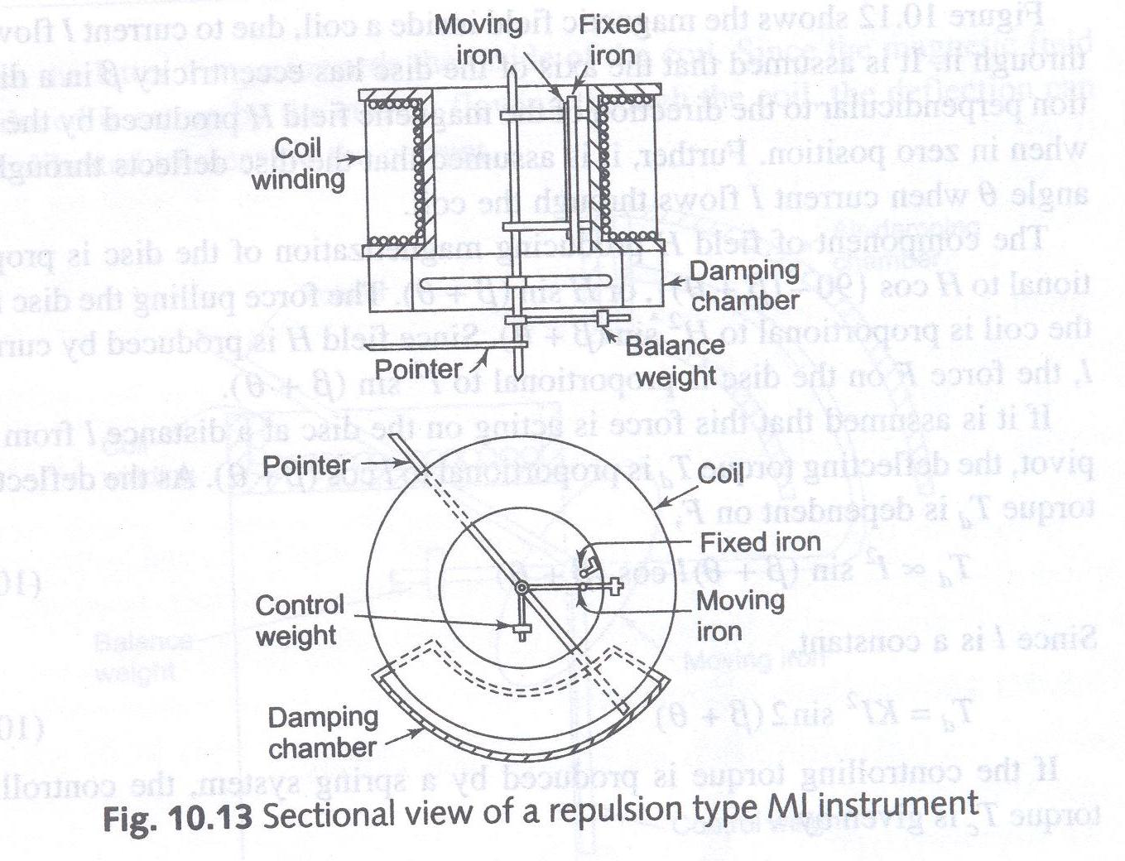

Slide 48
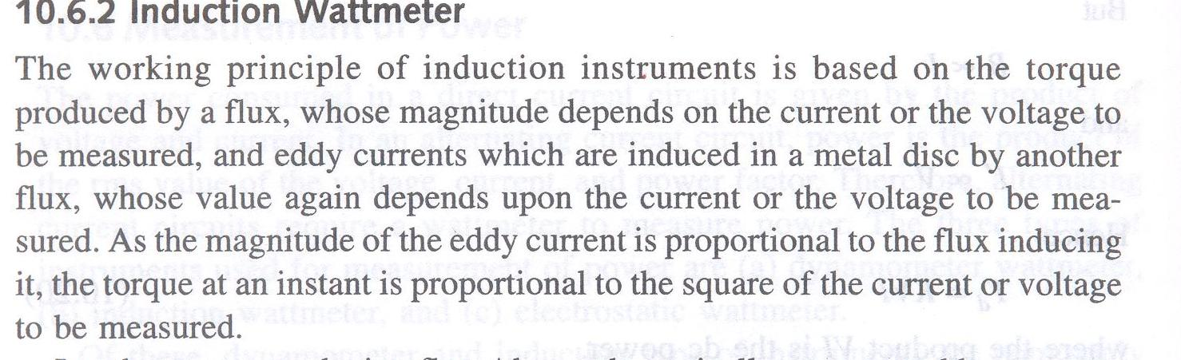

Slide 49
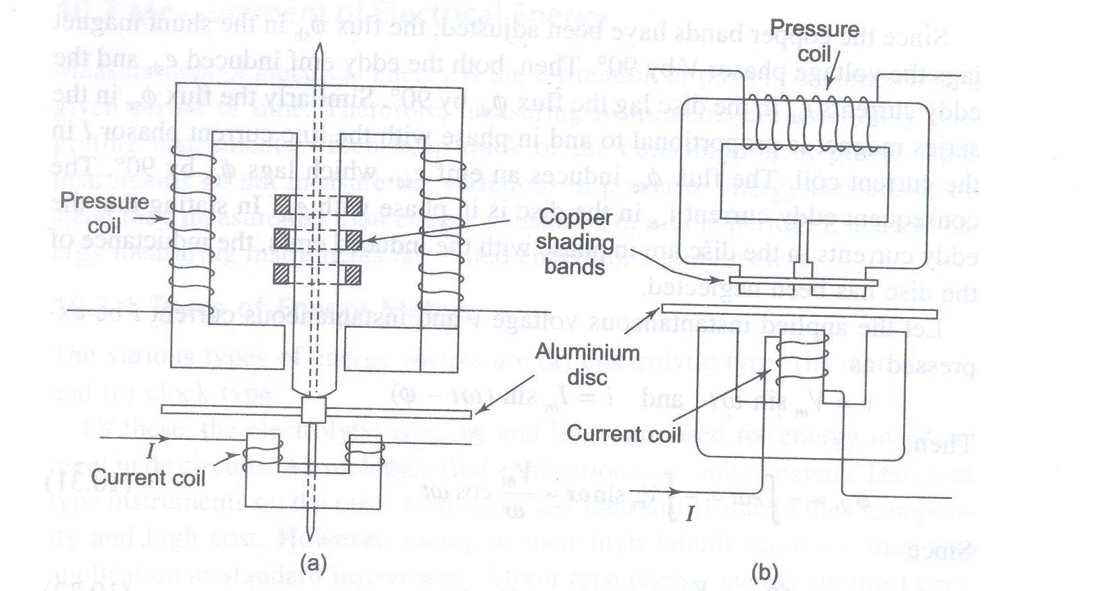

Slide 50
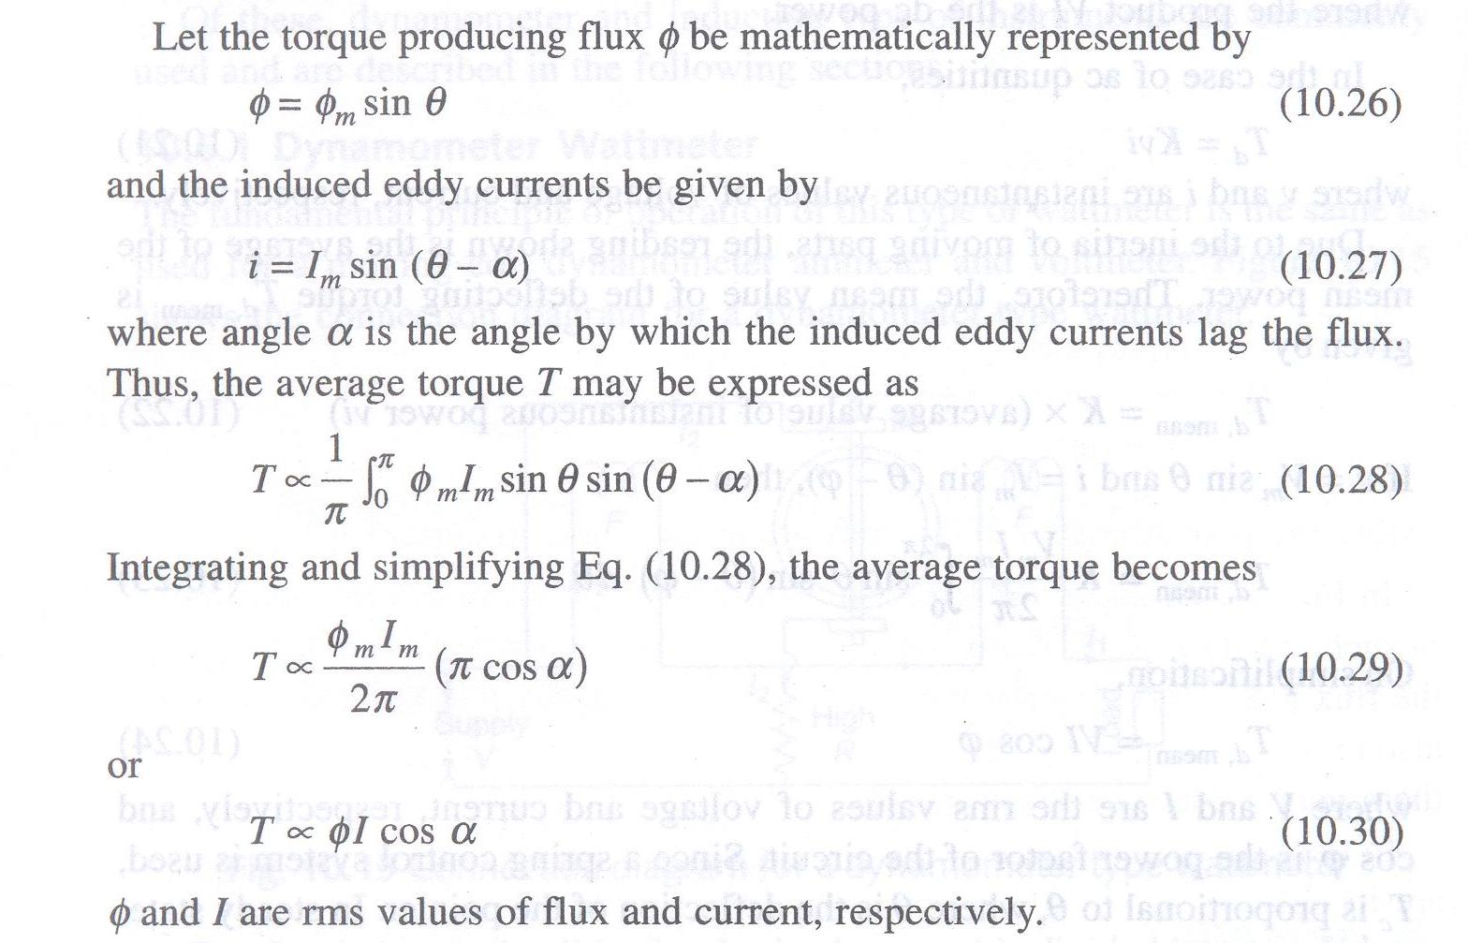

Slide 51
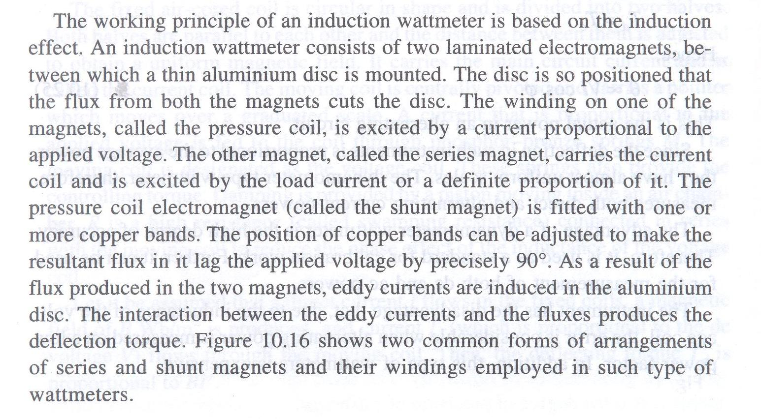

Slide 52
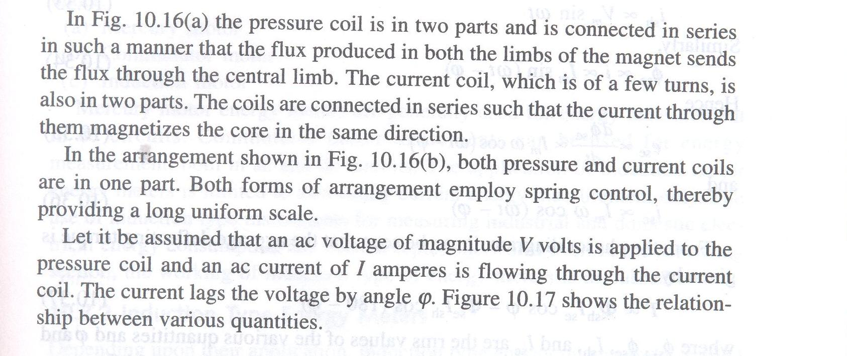

Slide 53
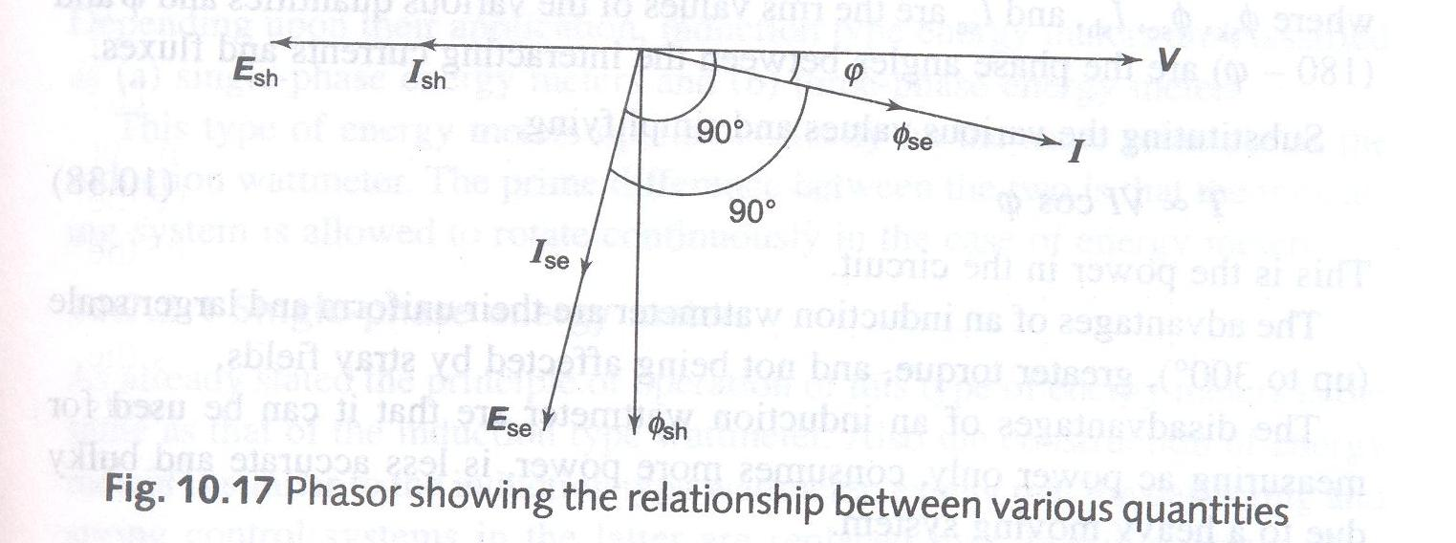
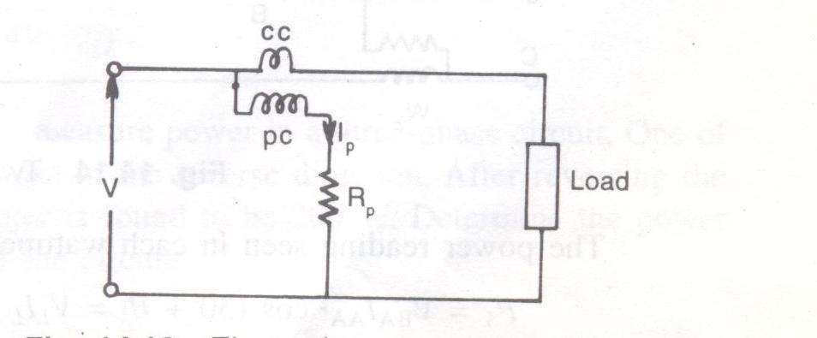
Electrical representation of wattmeter

Slide 54
Ac Watt-Hour meter
Electrical energy is measured by means of watt-hour meter, called energy meter. It is an integrated instrument and takes into account the power & time, the product of which gives the energy.
The ac watt-hour meter works on the principle of induction. It essentially consists of the following systems (a) Driving system (b) Moving system
( c) Braking system (d) Registering system

Slide 55
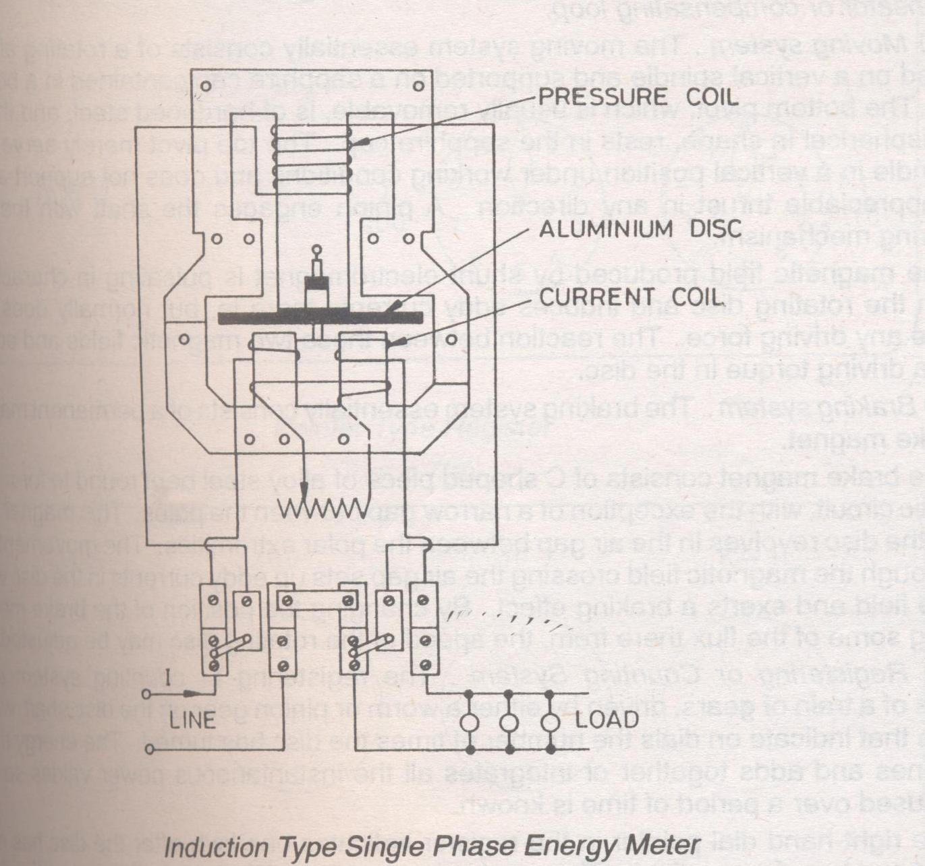

Slide 56
Driving system
It consists of two electromagnets, called“shunt” magnet and “series” magnet, of laminated construction. A coil having large number of turns of fine wire is wound on the middle limb of the shunt magnet.
This coil is known as “pressure or voltage” coil and is connected across the supply mains. This voltage coil has many turns and is arranged to be as highly inductive as possible. In other words, the voltage coil produces a high ratio of inductance to resistance.

Slide 57
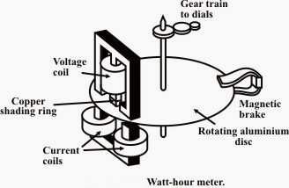
Driving system

Slide 58
Moving System
The moving system essentially consists of a light rotating aluminium disk mounted on a vertical spindle or shaft. The shaft that supports the aluminium disk is connected by a gear arrangement to the clock mechanism on the front of the meter to provide information that consumed energy by the load.
The time varying (sinusoidal) fluxes produced by shunt and series magnet induce eddy currents in the aluminium disc.
The number of rotations of the disk is therefore proportional to the energy consumed by the load in a certain time interval and is commonly measured in kilowatt-hours (Kwh).

Slide 59
Braking System
Damping of the disk is provided by a small permanent magnet, located diametrically opposite to the a.c magnets. The disk passes between the magnet gaps. The movement of rotating disc through the magnetic field crossing the air gap sets up eddy currents in the disc that reacts with the magnetic field and exerts a braking torque.
By changing the position of the brake magnet or diverting some of the flux there form, the speed of the rotating disc can be controlled.

Slide 60
Braking System
The registering or counting system essentially consists of gear train, driven either by worm or pinion gear on the disc shaft, which turns pointers that indicate on dials the number of times the disc has turned.
The energy meter thus determines and adds together or integrates all the instantaneous power values so that total energy used over a period is thus known.

Slide 61
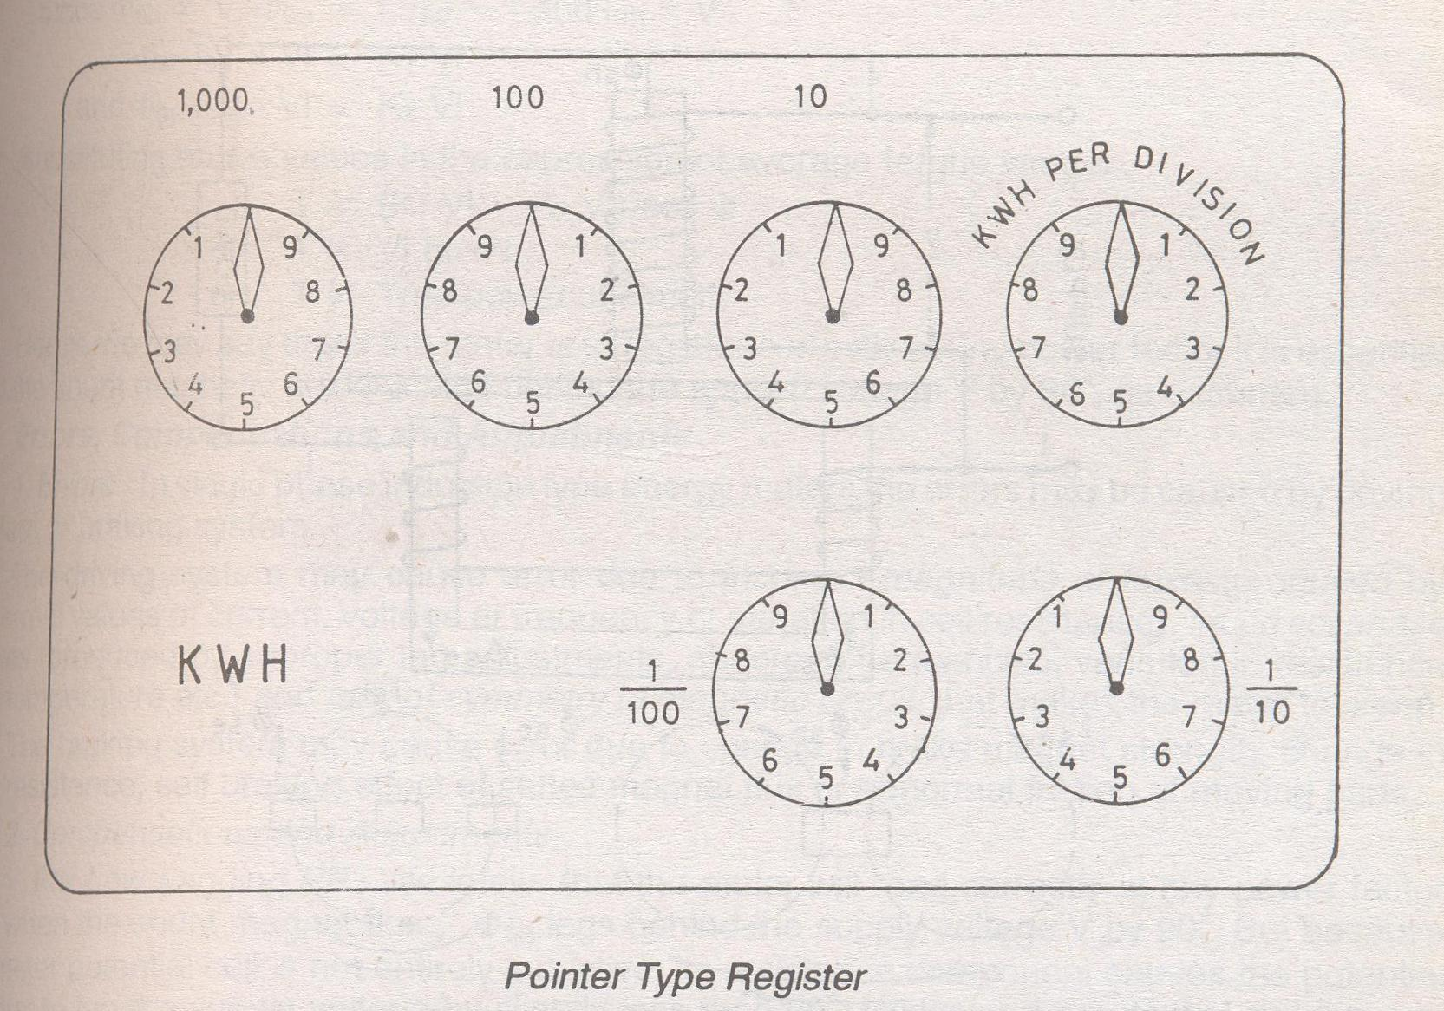
Registering or counting system:

Slide 62
Multi meter
A multi meter is capable of measuring dc & ac voltages, current & resistance. The three main characteristics of multi meters are :
(i) the input impedance is very high , varying from 1 to 10 mΩ
(ii) can respond to high frequency of MHz

Slide 63
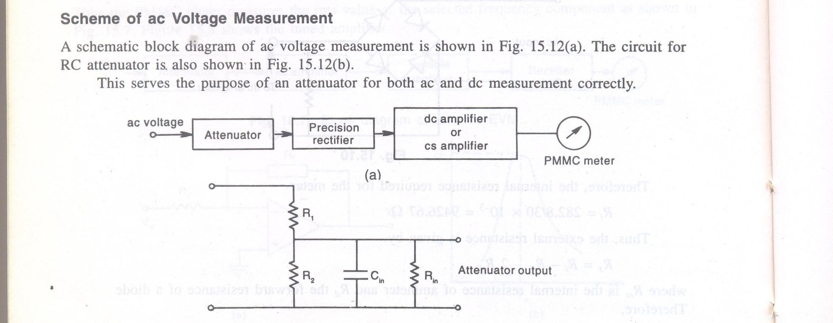

Slide 64
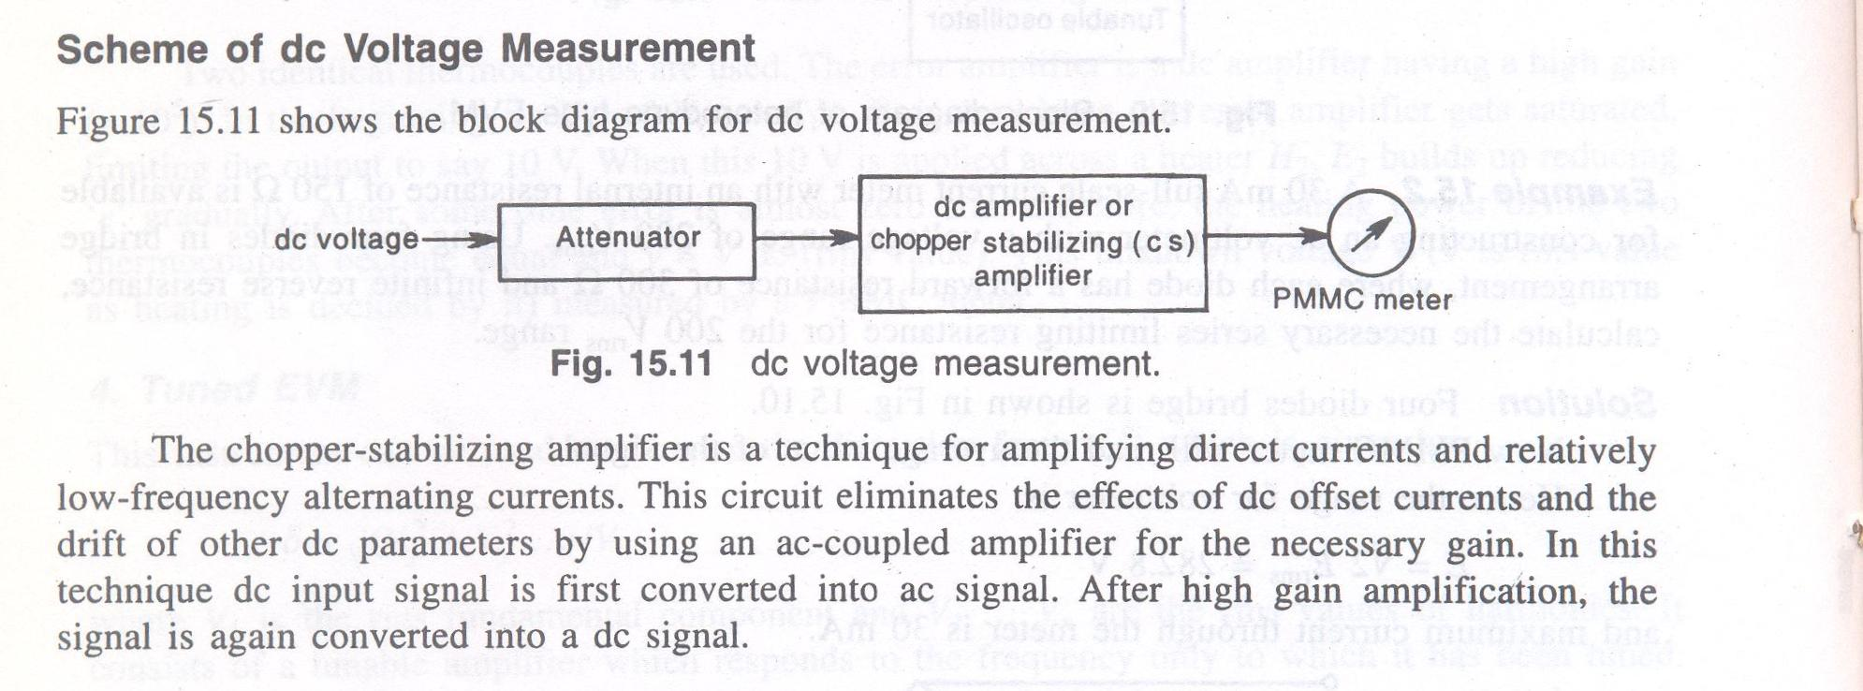

Slide 65
